Slide 1

Department of Software Engineering Capstone Project Phase B Braude College of Engineering, Israel Project 24-2-R-4
Anomalies Detection Using Graph Diffusion Model
Capstone Project Phase B
Students:
Roei Nizri – RoeiNizri1@gmail.com, 318260742
Ran Polac – RanPolac@gmail.com, 318265808
Supervisors: Dr. Renata Avros, Prof. Zeev Volkovich
Notes:
RAN
Hello to everyone, My name is Ran Polac , My partner is Roei Nizri, and we are excited to share the results of our research on Anomalies detection using graph Diffusion Models.
In the next couple of minutes , we will explore how the methods we've learned about can be applied to detect and classify anomalies in several Databases.

Slide 2
Table of Contents
Introduction
Background
The Model:
Pre-process, General process, Dataset, Training
Results
Conclusion
Demonstration
Notes:
In Phase 1 of our research project, we identified that self-citations, collaborations, and field-specific patterns create structured relationships in citation networks. This complexity makes it challenging to distinguish true anomalies from natural citation behaviors. From here, we will remember some concepts of Graph Diffusion and anomaly detection and dive into the model, explaining how it addresses these complexities to improve anomaly detection.

Slide 3

Graph Anomaly Detection
The process of identifying unusual nodes, edges, or substructures in a graph.
Unlike standard anomaly detection, it considers both node attributes and structural relationships.
Used in networks, transaction graphs, cybersecurity, and various real-world graph-structured data.
Notes:
Graph anomaly detection is the process of identifying irregular patterns, unusual behaviors, or unexpected structures within a graph. Graphs are a powerful way to represent real-world data, where entities (nodes) are connected through relationships (edges). Unlike traditional anomaly detection in tabular data, graph anomaly detection must account for both individual node attributes and structural relationships between entities.
Unlike standard anomaly detection, which deals with independent data points, graph anomaly detection requires analyzing both individual node/edge properties and the overall structure of the graph. Anomalies can emerge in different ways—some may involve isolated suspicious nodes, while others arise from subtle changes in connectivity patterns within the graph.

Slide 4
The Challenges
Complexity :Academic networks consist of vast and complex datasets with intricate relationships between publications and authors. Detecting anomalies in citations is challenging.
Volume: The sheer volume of publications and the complexity of citation networks make it difficult to process and analyze data efficiently.
Scalability: Ensuring that our detection methods can scale with the growth of academic publications is crucial.
Detecting Anomalies: Differentiating between legitimate citation behaviors (such as self-citations or collaborative citation clusters) and true anomalies requires sophisticated techniques to avoid false positives and ensure accuracy.
Notes:
Challenges in Anomaly Detection
Complexity:
The dataset has complex relationships which makes it harder to detect anomalies.
Volume: With a large number of data, processing the data efficiently is challenging. Additionally, there may not be enough data for certain types of anomalies..
Scalability: As the dataset grows, our detection methods need to scale to handle the increasing volume.
Detecting citations: It’s important to differentiate between normal citation patterns and unusual ones that might indicate fake citations (false positives).
These challenges highlight why anomaly detection in the dataset is both difficult and essential.

Slide 5
Types of Citations
Self citations
Collaborative citations
External citations
Notes:
RAN

Slide 6
Background
Notes:
ROEI
Thank you Ran. Now, I will provide some background to give context to this topic. This will help us remember and understand why this subject is important and what led to its development.

Slide 7
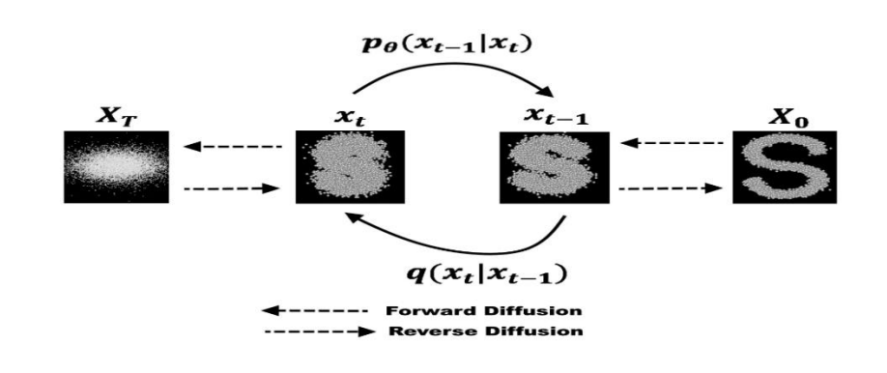
Diffusion models
Diffusion models were introduced in 2015 as a method to learn a model that can sample from a highly complex probability distribution.
The model has the ability to generate realistic graph structures and node features, which can be used to create synthetic anomalies.
Operates by adding noise to data points and then learning to reverse this process, effectively generating data points from noise.
Notes:
To remember, Diffusion models help in tasks like anomaly detection and synthetic data generation like in our needs
Diffusion models work by adding noise to data and then learning to reverse the process.
This allows to generate realistic graph structures and even create synthetic data by changes over the process.
In our research model, we adds noise to the data over multiple steps – in forward diffusion, due to
the model success learns to reverse this process to recover or generate new data.

Slide 8
Requirements:
The model allow simultaneously learns graph structures and node features in a multitask fashion.
The model allow to generates synthetic anomalous examples, enriching the dataset and balancing class distributions.
The model Improves anomaly detection by providing more diverse and representative training data.
Notes:
Researchers have developed various models that take advantage of the structural properties of graphs.
The approach in our research uses diffusion model to generate graphs while learning both structures and node features at the same time.
It creates synthetic anomalies examples, which help balance datasets and improve model training.

Slide 9
Node Feature: Represents various attributes associated with the node, such as metrics or characteristics that describe its properties and behavior within the graph.
Node Timestamp: A temporal marker indicating when a specific event or interaction involving the node occurred, crucial for analyzing the temporal dynamics of the network.
Feature Normalization: Node features were normalized to maintain consistent scaling.
Pre Graph Construction: The dataset was transformed into an adjacent matrix format, allowing the model to effectively capture relationships between nodes.
Pre-process
Notes:
Before using the data, we need to preprocess it to ensure it’s ready for the model.
First, we extract Node Features, which describe the properties of each node.
Next, we consider the Node Timestamp, which helping us analyze time-based patterns.
Then, we apply Feature Normalization to scale data consistently and prevent model bias
Finally, we perform Pre Graph Construction, converting the dataset into a structured format that captures relationships between nodes.

Slide 10
Process
Notes:
Now we get preprocessed data, let’s move on to the process itself. This step involves applying the model, training, and analyzing the results

Slide 11
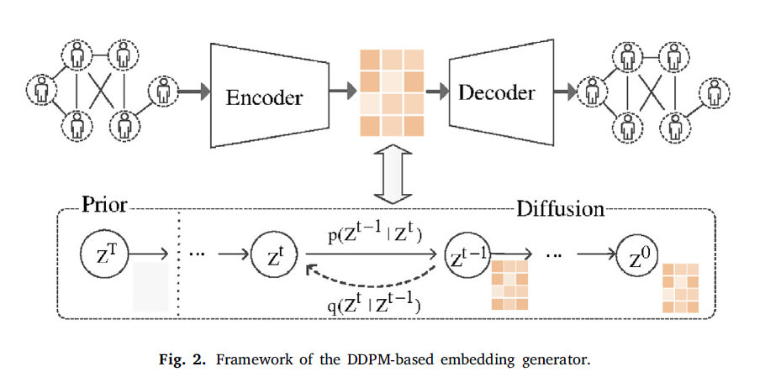
The Model
Graph Construction
GAE
DDPM
Notes:
let’s remember the modules of the model we used.
First, Graph Construction, we build the graph structure by defining nodes, edges, and their relationships.
Each node should have features such as text embeddings, author information, and publication details..
Next, GAE (Graph Autoencoder), which helps in learning a compressed representation of the graph, We use a graph Convolutional network (GCN) to encode the graph into a latent space, capturing the structural and feature information. After we Train the autoencoder to reconstruct the original graph from the latent representation.
Finally, DDPM (Denoising Diffusion Probabilistic Model), which add noise to the data and learns to reverse it, allowing for better graph generation and anomaly detection.
Together, these components analyzing the anomalies better.

Slide 12
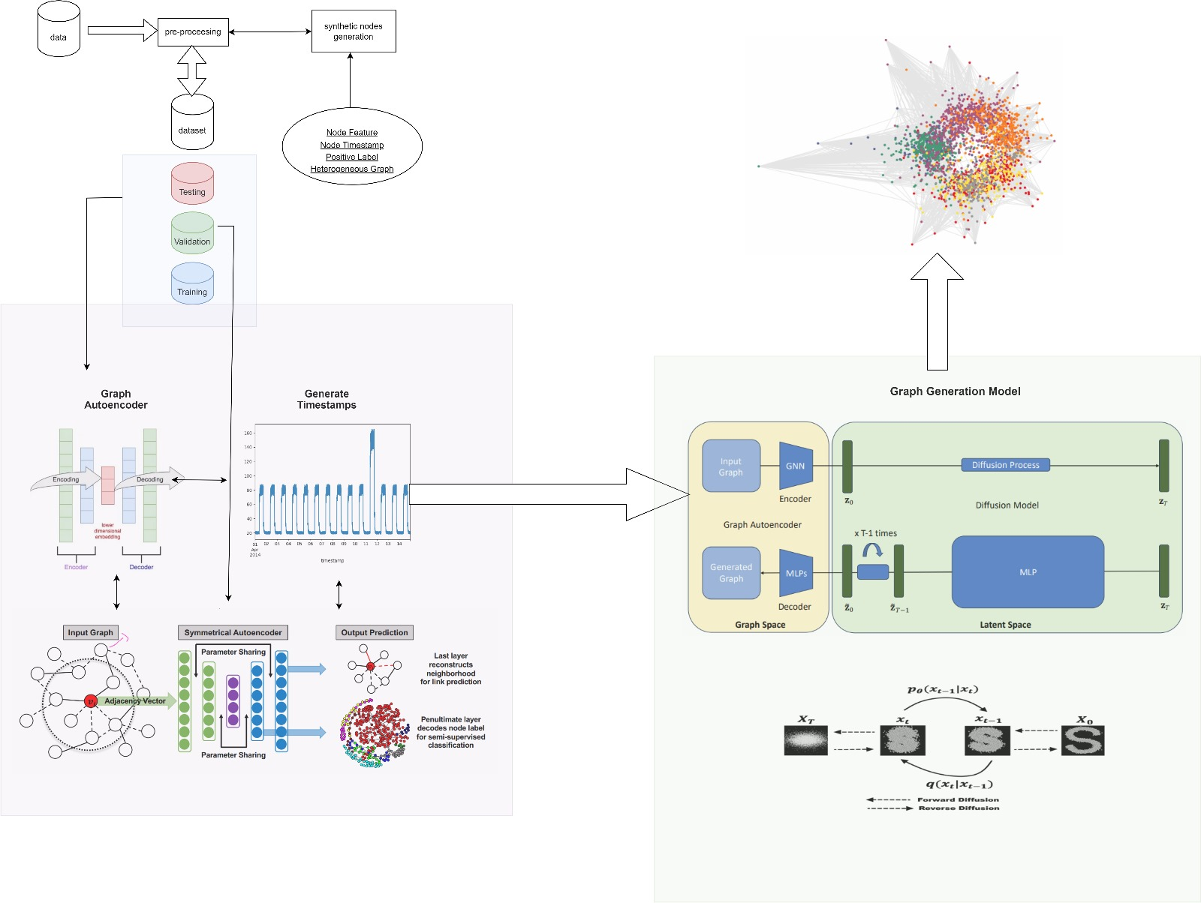
Notes:
Here we can see the general architecture of the model and how all the parts are merged.
First, we start with data preprocessing as I explained.
Next, we use a Graph Autoencoder. it uses encoders and decoder , learns meaningful representations from the the organize graph.
We also generate timestamps, which help in analyzing the temporal dynamics.
Finally, the Graph Generation Model combines a GCN and a Diffusion Process to generate realistic graphs.
Practicality, We create latent embeddings z and sample random noise vectors and add them to z.
We label some of these anomalies if their noise level crosses a limit.
For these missions we used also` MLP to train the model that classifies whether a node is “anomalous” or “normal” based on the latent vectors.
In the demonstration we will see - Real nodes (latent_z) labeled as normal (0) and Synthetic nodes (latent synthetic_z) labeled as anomalies (1).
Let’s dive more to the process, ran will continue.

Slide 13
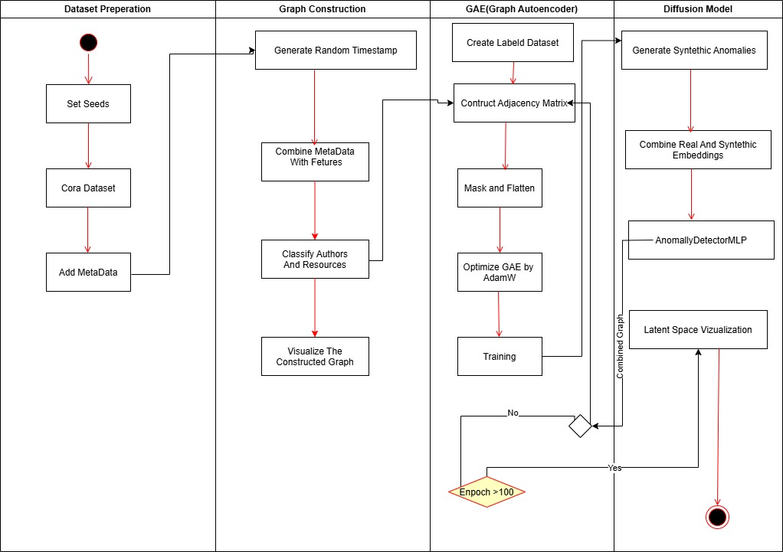
Activity Diagram
Notes:
RAN
Diffusion Model in the Latent Space to Generate Synthetic
Adds noise to the data over multiple steps (forward diffusion). Learns to reverse this process to recover (or generate new) data. Below, we show a very simplified placeholder approach to create “anomalies”:
We take latent embeddings z. We sample random noise vectors, add them to z. We label some of these “anomalous” if their noise level crosses a threshold or by random sampling.
Build a Classifier for Anomaly Detection - AnomalyDetectorMLP
Train the model that classifies whether a node is “anomalous” or “normal” based on the latent vectors. Our training set will consist of: Real nodes (latent z) labeled as normal (0).
Synthetic nodes (latent synthetic_z) labeled as anomalies (1).

Slide 14
Datasets – Cora And CiteSeer
represents a citation network, where nodes correspond to scientific publications and edges represent citations.
Cora - consists of 2708 scientific publications classified into one of seven classes. The citation network consists of 5429 links.
CiteSeer-consists of 3327 scientific publications classified into one of 6 classes. The citation network consists of 4732 links.
Widely used in graph-based machine learning, including node classification, link prediction, and anomaly detection.
Notes:
At the beginning of the project, we worked with a single dataset – Cora.
However by professor Zeev consulting, we add CiteSeer to evaluate how our model performs on different datasets. Incorporating both datasets allowed us to examine the flexibility and effectiveness of our approach in different graph structures.

Slide 15
Hyper-Parameters
Loss Functions:
Epochs: 100
Batch Size: 64
Optimizer: GAE
Binary Cross-Entropy.
Weighted Binary Cross-Entropy.
Synthetic nodes: 500
Notes:
BY ADAMW

Slide 16
Results

Slide 17
Running Method
We tested two different methods in our project:
Standard Run – Running the model with a fixed dataset configuration.
Multiple Running Approach – Iteratively changing the number of anomalies and observing how the model adapts and improves over multiple runs.
By comparing these approaches, we gained deeper insights into how graph diffusion models handle anomaly detection under varying conditions.

Slide 18
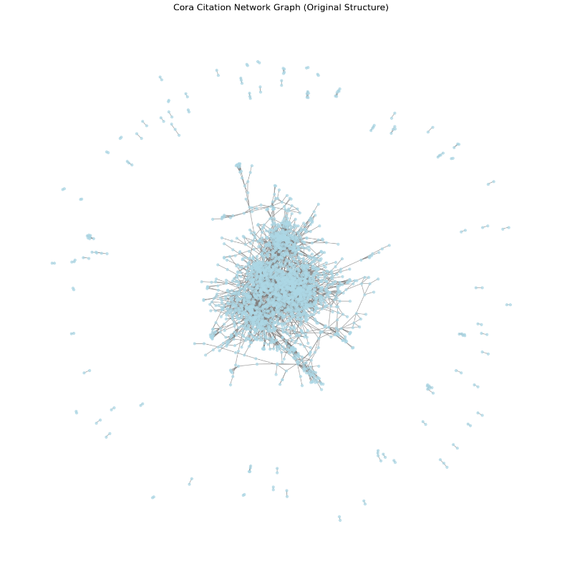
Citation Network Graph
Notes:
The central dense region likely represents a well-connected group of papers frequently citing each other.
The outliers (nodes far from the center) could be potential anomalies, indicating unusual citation patterns.

Slide 19
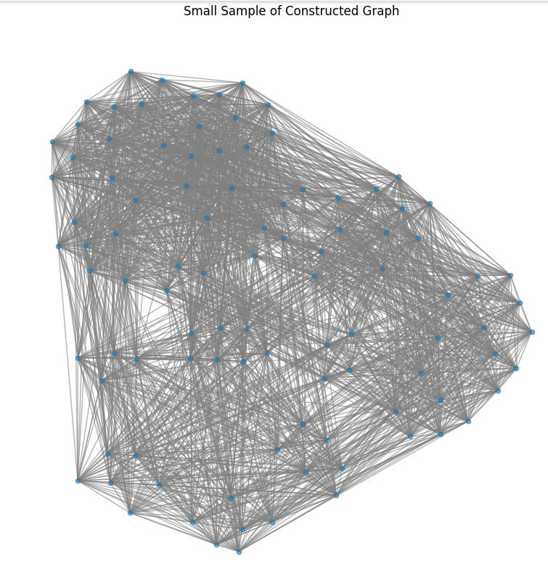
Cora
Notes:
Nodes: Represent papers (or entities) in the Cora dataset.
Edges: Represent citations or relationships between nodes.

Slide 20
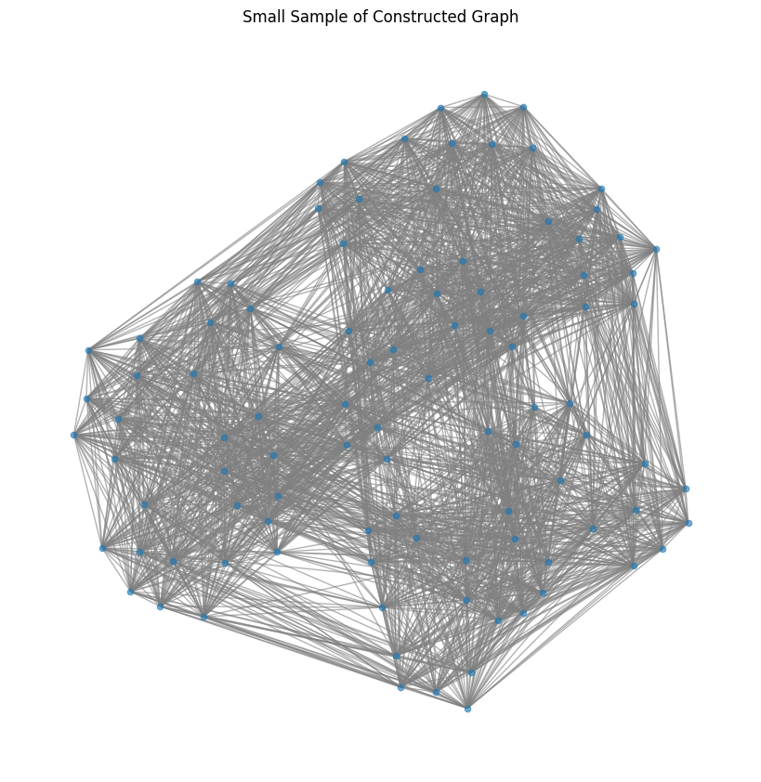
CiteSeer
Notes:
Nodes: Represent papers (or entities) in the Citeseer dataset.
Edges: Represent citations or relationships between nodes.

Slide 21
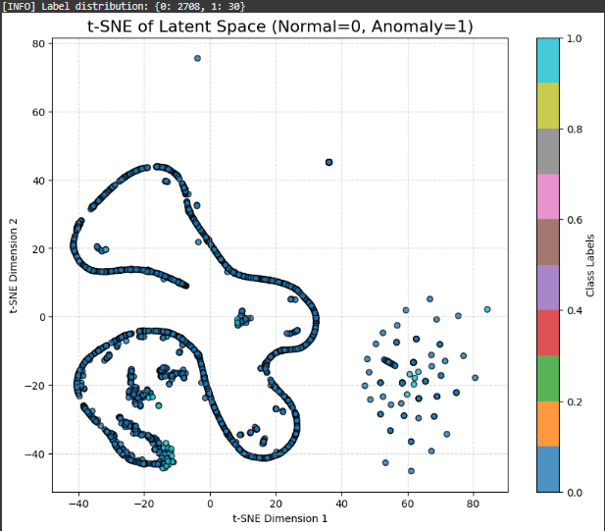
Notes:
The anomalies detected are structurally different from normal nodes, proving that the model effectively identifies citation irregularities.
The diffusion-based anomaly detection method successfully separates normal and anomalous data.

Slide 22
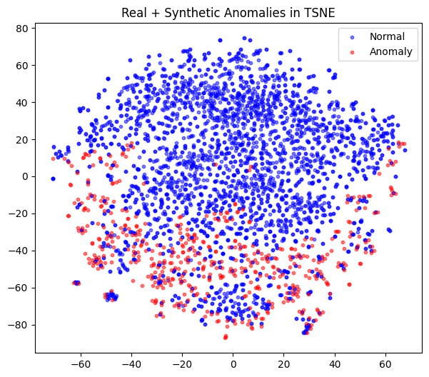
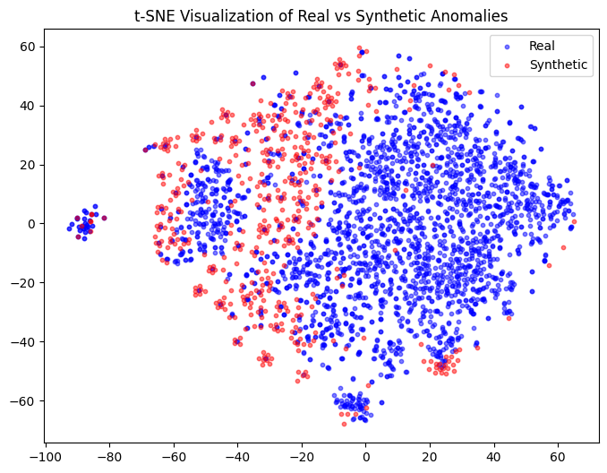

Slide 23
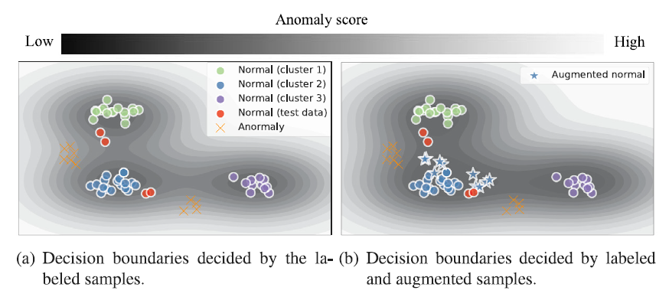
illustrates the effect of synthetic data on anomaly detection decision boundaries.
Notes:
ROEI
Now, Let’s understand how synthetic data impacts anomaly detection.
Synthetic data fills gaps in the dataset by generating new realistic samples.
It helps the model understand variations in normal data, making it easier to detect truly abnormal points
On the left, we see decision boundaries created using only labeled samples. The model struggles to clearly separate normal and anomalous points.
The boundaries between normal and anomalous data are not very clear because the model has limited information.
On the right, we include synthetic data, which helps refine decision boundaries, making the anomaly detection more accurate.
You can see that the decision boundaries are more well-defined, reducing the overlap between normal and anomalous regions.
The model can better distinguish between normal and abnormal data points.
Answer to questions: 1. What does the left image represent?
The left image shows decision boundaries created using only labeled samples.
2. What does the right image represent?
The right image includes synthetic data (augmented samples) generated using diffusion models.
These additional samples help the model refine decision boundaries, making it easier to separate anomalies from normal data.
3. How does synthetic data improve anomaly detection?
The decision boundary becomes more precise, reducing false positives (normal points mistakenly labeled as anomalies) and false negatives (missed anomalies).

Slide 24
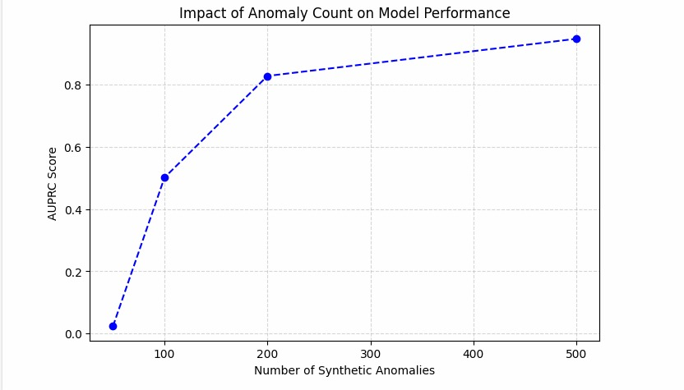
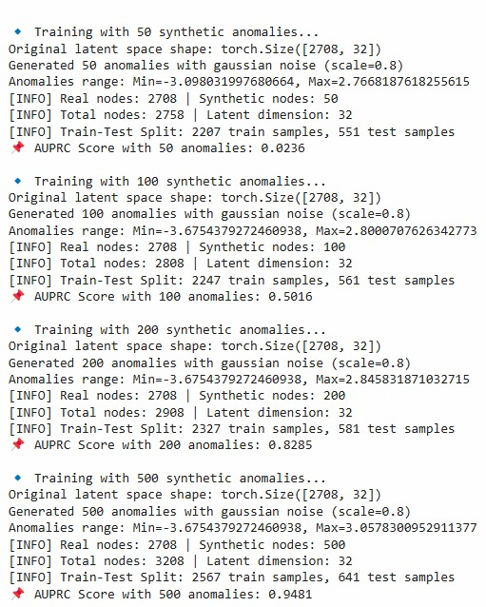
Notes:
In addition, in this slide we see how the number of synthetic anomalies affects the model's performance.
On the left, we have a graph plotting the AUPRC Score (Area Under the Precision-Recall Curve) against the Number of Synthetic Anomalies. As we add more synthetic anomalies, the model's performance improves significantly.
On the right, we see the details of different training runs with varying numbers of synthetic anomalies. The recall curve score increases as we introduce more synthetic anomalies, showing that generating additional data helps the model detect anomalies more accurately.

Slide 25
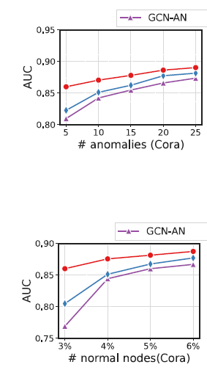
Notes:
This slide also presents the model’s AUC (Area Under the Curve) performance based on different numbers of normal and anomalous nodes in the Cora dataset.
On the left, the graph shows how AUC improves as the percentage of normal nodes increases. As more normal data is included, the model learns better. On the right, we see the impact of increasing the number of anomalies—more anomalies help the model generalize better and improve detection accuracy.
The red line is the research model, consistently outperforms the others. The purple and blue lines (KNN, Logistic Regression we will talk about them later) show improvement but remain lower in performance.
From this, we learn that the ratio between synthetic nodes to normal nodes is crucial. It is not possible to overload the model with synthetic data; rather, it must be done smartly to ensure optimal learning and performance.

Slide 26
Testing
Factor | Description
Sample Size (Dataset Size) | Training set size: ~2000-2300 nodes Test set size: ~500-600 nodes Validation set size: ~200 nodes (varies with anomaly count)
Gaussian Noise Applied? | Yes, synthetic anomalies are generated with Gaussian noise
Noise Scale | 0.8 (used when generating synthetic anomalies)
Models Compared | Isolation Forest, Logistic Regression, KNN (with PCA), Graph Autoencoder
Split Data | 70% Train, 20% Test, 10% Validation
Notes:
Example of Cora data set setup:
Sample Size: around 2,200 nodes to train set, while the test set has about 500 nodes and validation got around 200 nodes
The exact numbers depend on the anomaly count.
We introduce synthetic anomalies using Gaussian noise
With a noise scale of 0.8.
for tuning hyperparameters and preventing overfitting,
The model is trained on the Train Set; it is evaluated on the Validation Set to assess its performance.

Slide 27
Model | Trained On? | Uses Graph Structure? | Handles High Dimensions? | Performance
Isolation Forest | PCA-reduced embeddings (10D) | No | Struggles with 10D features | Fails completely (AUROC ~0.02)
Logistic Regression | Full embeddings (64D) | No | Not good for complex patterns | Weak performance (~0.53 AUROC)
KNN (with PCA) | PCA-reduced embeddings (10D) | No | Learning distances well | Performs well (AUROC ~0.96)
Graph Autoencoder (GAE) with DDPM | Learned graph embeddings (64D) | Yes | Learns relationships | Best model (AUROC ~0.98)
Notes:
In the testing and evaluation phase, we focus on:
Evaluation Metrics: We use key metrics like the curves - AUROC and AUPRC to measure how well the model classifies anomalies.
Performance Comparison: We compares different models used for anomaly detection, highlighting their strengths and weaknesses.
Isolation Forest: Trained on PCA-reduced embeddings (a vector with 10 values) but doesn’t use graph structure. It struggles with low-dimensional features and fails completely
KNN with PCA: Also trained on PCA-reduced embeddings (a vector with 10 values) and performs well by learning distances between points.
Logistic Regression: Trained on full embeddings (a vector with 64 values) but also doesn’t use graph structure. It’s not good at handling complex patterns, leading to weak performance
The model of our research - Graph Autoencoder (GAE) with DDPM: Trained on learned graph embeddings (a vector with 64 values) and is the only model that uses graph structure.
It learns relationships between nodes, making it best
Lets continue.

Slide 28
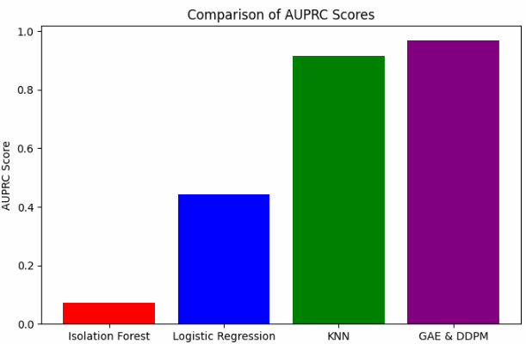
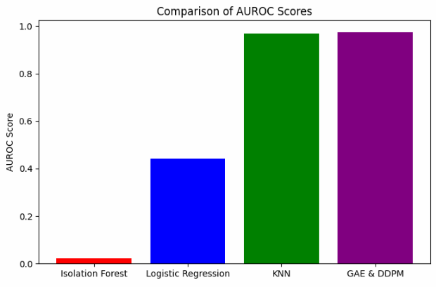
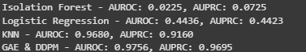
Notes:
AUPRC (Area Under the Precision-Recall Curve) – shown on the left
AUROC (Area Under the Receiver Operating Characteristic Curve) – shown on the right
Isolation Forest performs the worst, with very low scores.
Logistic Regression does better but still struggle, with moderate scores.
KNN (with PCA) performs well, showing a significant improvement.
The research model GAE & DDPM (Graph Autoencoder with Diffusion Model) is the best performer, achieving the highest scores.
These results confirm that using graph-based models, especially with diffusion techniques, leads to good anomaly detection performance.
Adding what is pca:
PCA (Principal Component Analysis) is a dimensionality reduction technique used in machine learning and data analysis. It helps simplify large datasets by transforming them into a smaller number of important features while preserving as much information as possible.

Slide 29
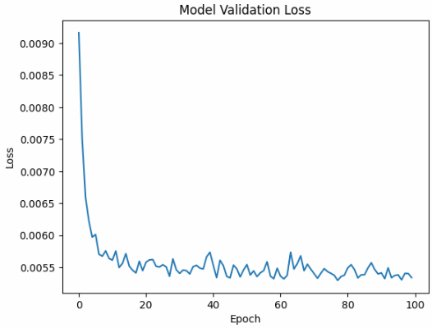
Notes:
In addition, During fine-tuning, we checked for overfitting using a validation test.
The validation results were slightly worse than the training results, showing that we haven’t overfitting.
This helped us ensure the model learns well without just memorizing the training data.
And ran will continue with the result.

Slide 30
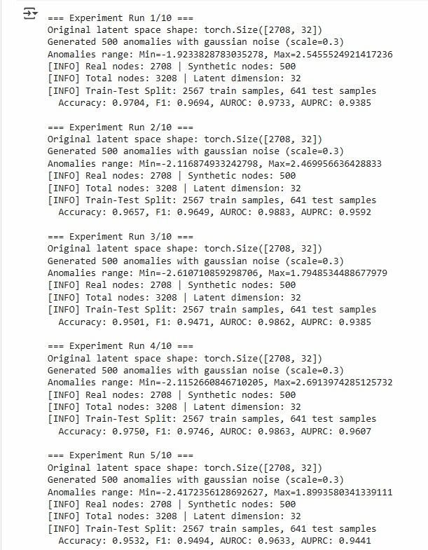
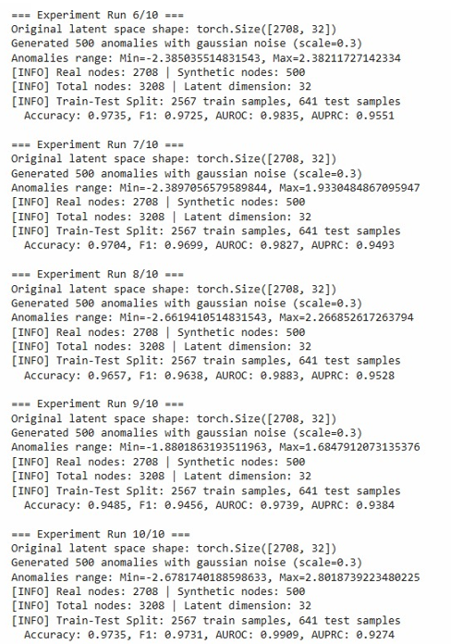
Results – Multiple Running
Notes:
RAN
Significance:
High accuracy and F1-score (~0.963) indicate that the model performs well in distinguishing anomalies.
AUROC and AUPRC are lower than accuracy but still very strong (~0.94-0.98), meaning that the model maintains good performance despite class imbalance.
The results confirm that introducing synthetic anomalies and Gaussian noise significantly improves anomaly detection accuracy.

Slide 31
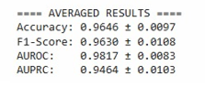
Results – Multiple Running
High accuracy and F1-score (~0.963) indicate that the model performs well in distinguishing anomalies.
AUROC and AUPRC are lower than accuracy but still very strong (~0.94-0.98), meaning that the model maintains good performance despite class imbalance.
The results confirm that introducing synthetic anomalies and Gaussian noise significantly improves anomaly detection accuracy

Slide 32
Conclusions
Through these experiments, we demonstrated that graph diffusion models effectively enhance anomaly detection by capturing both local and global structures in citation networks.
The ability to generate synthetic anomalies further improved performance, addressing challenges like label imbalance and data sparsity.
This study highlights the potential of advanced graph-based models in handling real-world anomaly detection tasks and opens the door for future research into scalability, efficiency, and applicability in other domains.
Notes:
In this project, we explored anomaly detection using graph diffusion models, starting with the Cora dataset and later expanding to CiteSeer to evaluate the model’s adaptability to different graph structures.

Slide 33

Thank you for listening!
Any questions?
Notes:
Thank you all for your attention and for joining us this evening.
We are happy to answer questions you might have.

